Slide 1
Lecture - 4
Microbial Nutrition, Ecology and Growth
Talaro’s Foundations in Microbiology
12th Edition
Barry Chess

Slide 2
Contents:
Elements of Microbial Nutrition - sources of essential nutrients
Nutritional types
Ecological associations among microorganisms
Environmental factors influencing microbial growth

Slide 3
Microbial Nutrition
There are millions of habitats on earth - both natural and human origin.
Example: - the North and South poles, deserts, rocks, oceans, mining sites etc.
In these settings, microorganisms are exposed to a variety of conditions that affect their survival.
Microbes survive in their habitats by gradually adjusting to these conditions - a process called adaptation.

Slide 4
Microbial Nutrition
Microbes live on earth in different environmental conditions.
Environmental factors affecting the survival of microorganisms are:
Nutrient and energy sources
Temperature
Gas content
Water
Salt
pH
Radiation and other organisms.

Slide 5
Microbial Nutrition
Microbial nutrition is a complex activity through which microbes acquire chemical compounds from the environment in order to sustain life.
Nutrition - Process by which chemical compounds (nutrients) are acquired from the environment to sustain life
In microbial nutrition, the compounds are absorbed, assimilated and subsequently used for cellular metabolism, growth, energy etc.

Slide 6
Microbial Nutrition
  All living organisms need several elements for their survival and growth.
  Bioelements – basic requirements for life
  carbon
  hydrogen
  oxygen
  phosphorus
  potassium
  nitrogen
  sulfur
  calcium
  iron
  sodium
  chlorine
  magnesium

Slide 7
Chemical Analysis of Cell Contents
70% water
97% of dry cell weight is organic compounds:
  Proteins the most prevalent
96% of cell is composed of 6 elements:
  Carbon
  Hydrogen
  Oxygen
  Phosphorous
  Sulfur
  Nitrogen

Slide 8
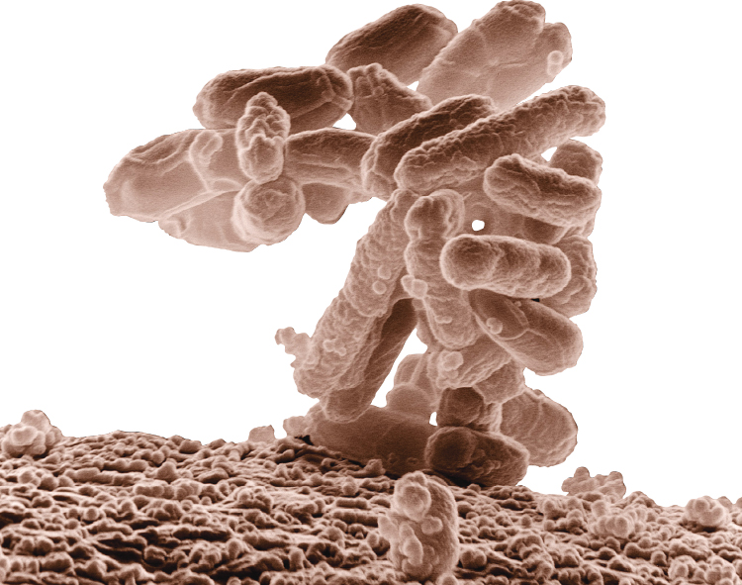
Energy Extraction of Microorganisms
Chemical analysis of cell contents - Escherichia coli cell
Water - 70 %
Proteins - 15 %
Nucleic acids - 7 % (DNA 1% and RNA 6%)
Carbohydrates - 3%
Lipids - 2%
Escherichia coli (SEM 7000X)
Source: Eric Erbe/Chris Pooley, USDA-ARS

Slide 9
Essential Biological Nutrients
TABLE 7.1 Sources and Biological Functions of Essential Elements and Nutrients
Carbon
Elements/Nutrients Forms Found in Nature:
Sources/Reservoirs of Compounds:
  Air (0.036%*)
  Sediments/Soils
  Living Things
Significance to cells: CO₂ is produced by respiration and used in photosynthesis; CO₃²⁻ is found in cell walls and skeletons; organic compounds are essential to the structure and function of all organisms and viruses.

Slide 10
Essential Biological Nutrients
Nitrogen
Elements/Nutrients Forms Found in Nature:
Sources/Reservoirs of Compounds:
  Air (79%*)
  Soil and water
  Organisms
nitrite
Nitrogen - Significance to cells: Nitrogen gas is available only to certain microbes that fix it into other inorganic nitrogen compounds—nitrates, nitrites, and ammonium—the primary sources of nitrogen for algae, plants, and the majority of bacteria; animals and protozoa require organic nitrogen;
all organisms use NH₃ to synthesize amino acids and nucleic acids.

Slide 11
Essential Biological Nutrients
Oxygen
Elements/Nutrients Forms Found in Nature:
Sources/Reservoirs of Compounds:
  Air (20%*), a major product of photosynthesis
  Soil
Significance to cells: Oxygen gas is necessary for the metabolism of nutrients by aerobes. Oxygen is a significant element in organic compounds and inorganic compounds.

Slide 12
Essential Biological Nutrients
Hydrogen
Elements/Nutrients Forms Found in Nature:
Sources/Reservoirs of Compounds:
  Waters, swamps, mud
  Volcanoes, vents
  organisms
Significance to cells: Water is the most abundant compound in cells and a solvent for metabolic reactions; H2, H2S and CH4 gases are produced and used by bacteria and archaea; H⁺ ions are the basis for transfers of cellular energy and help maintain the pH of cells.

Slide 13
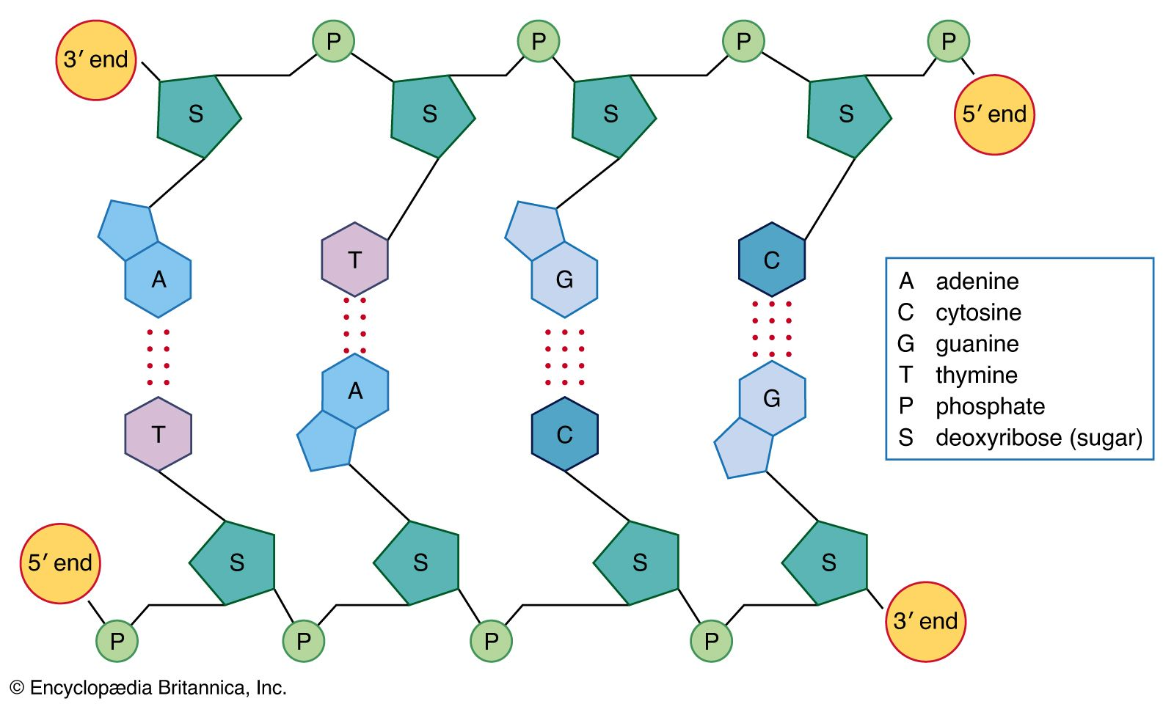
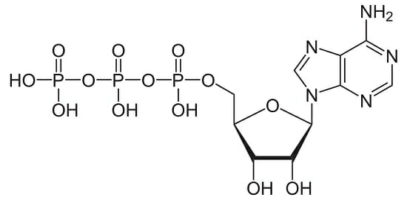
Essential Biological Nutrients
5) Phosphorus
Elements/Nutrients Forms Found in Nature:
DNA
Sources/Reservoirs of Compounds:
  Rocks, mineral deposits
  Soil
Significance to cells: Phosphate, a key component of DNA and RNA, is critical to the genetic makeup of cells and viruses; also found in ATP and NAD, where it takes part in numerous metabolic reactions; its presence in phospholipids provides stability to cell membranes.
ATP

Slide 14
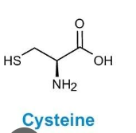
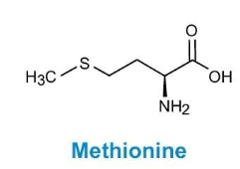
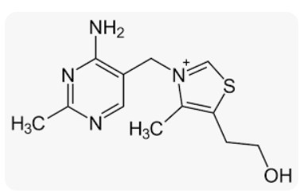
Essential Biological Nutrients
Sulfur
Elements/Nutrients Forms Found in Nature:
Sources/Reservoirs of Compounds:
  Mineral deposits volcanic sediments
  Soil
Vitamin B1
Significance to cells: Elemental sulfur (S) is oxidized by some bacteria as an energy source; sulfur is found in vitamin B1; sulfhydryl groups are part of certain amino acids, where they form disulfide bonds that shape and stabilize proteins.

Slide 15
Essential Biological Nutrients
Potassium
Elements/Nutrients Forms Found in Nature:
Sources/Reservoirs of Compounds:
  Mineral deposits, ocean water, soil
Significance to cells: Plays a role in protein synthesis and membrane transport

Slide 16
Essential Biological Nutrients
Sodium
Elements/Nutrients Forms Found in Nature:
Sources/Reservoirs of Compounds:
    Mineral deposits, ocean water, soil
Significance to cells: Major participant in membrane actions; maintains osmotic pressure in cells.
Calcium
Elements/Nutrients Forms Found in Nature:
Sources/Reservoirs of Compounds:
  Oceanic sediments, rocks, and soil
Significance to cells: A component of protozoan shells (as CaCO₃); stabilizes cell walls; adds resistance to bacterial endospores

Slide 17
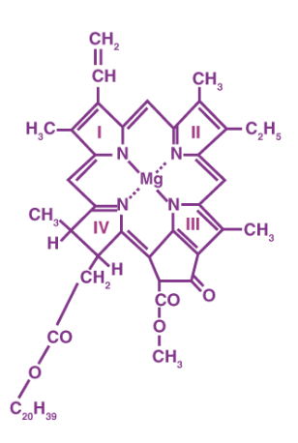
Essential Biological Nutrients 13
Magnesium
Elements/Nutrients Forms Found in Nature:
Sources/Reservoirs of Compounds:
    Geologic sediments, rocks, and soil
Significance to cells: A central atom in the chlorophyll molecule; required for function of membranes, ribosomes, and some enzymes
Chlorophyll

Slide 18
Essential Biological Nutrients 14
Chloride
Elements/Nutrients Forms Found in Nature:
Sources/Reservoirs of Compounds:
    Ocean water, salt lakes
Significance to cells: May function in membrane transport; required by obligate halophiles to regulate osmotic pressure

Slide 19
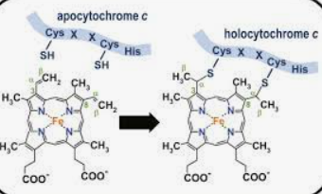
Essential Biological Nutrients 15
Zinc
Elements/Nutrients Forms Found in Nature:
Sources/Reservoirs of Compounds:
    Rocks, Soil
Significance to cells: An enzyme cofactor, regulates eukaryotic genetics
Iron
Elements/Nutrients Forms Found in Nature:
Sources/Reservoirs of Compounds:
  Rocks, Soil
Significance to cells: Essential element for the structure of respiratory proteins (cytochromes)
cytochromes

Slide 20
Essential Biological Nutrients 16
Micronutrients
Elements/Nutrients Forms Found in Nature: copper, cobalt, nickel, molybdenum, manganese, iodine
Sources/Reservoirs of Compounds:
  Geologic sediments, soil
Significance to cells: Required in tiny amounts to serve as cofactors in specialized enzyme systems of some microbes but not all

Slide 21
Growth Factors: Essential Organic Nutrients
Organic compounds that cannot be synthesized by an organism because they lack the genetic and metabolic mechanisms to synthesize them
Growth factors must be provided as a nutrient for survival
  Essential amino acids, vitamins

Slide 22
Classification of Nutritional Types
Main determinants of nutritional type are:
  Carbon source
    Heterotroph – from other organisms
    Autotroph – uses CO₂ as source
  Energy source
    Chemotroph – gain energy from chemical compounds
    Phototrophs – gain energy through photosynthesis

Slide 23
Sources of Essential Nutrients: Carbon-Based
Sources of the element carbon defines two basic nutritional types:
  Heterotroph – must obtain carbon in an organic form such as proteins, carbohydrates, lipids, and nucleic acids made by other living organisms
  Autotroph – an organism that uses CO₂, an inorganic gas, as its carbon source
    Not nutritionally dependent on other living things

Slide 24
Autotrophs and Their Energy Sources 1
Photoautotrophs
  Oxygenic photosynthesis (plants, algae, and cyanobacteria)
    Produce oxygen and use chlorophyll as the primary pigment
  Anoxygenic photosynthesis (purple and green sulfur bacteria)
    no oxygen but sulfur production, use bacteriochlorophyl as pigment

Slide 25
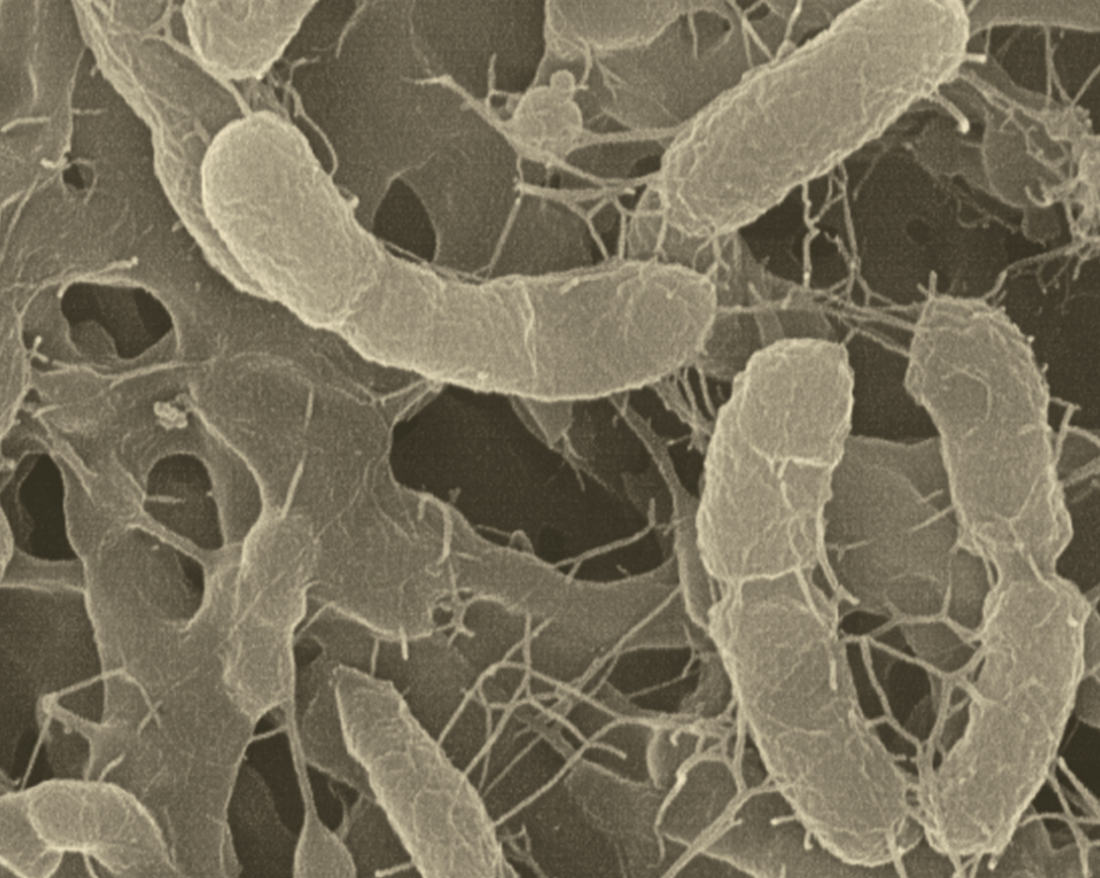
Autotrophs and Their Energy Sources
Chemoautotrophs (lithoautotrophs*) survive totally on inorganic substances
  Methanogens, a kind of chemoautotroph, produce methane gas under anaerobic conditions
*Lithoautotrophs - Organisms that use inorganic substrates like CO2 and mineral to obtain energy.
(a): Dr. Adrian Hetzer

Slide 26
Heterotrophs and Their Energy Sources
Majority are chemoorganotrophs:
  Derive carbon and energy from organic compounds, that is, aerobic respiration
Two categories:
  Saprobes: free-living microorganisms that feed on organic detritus from dead organisms
    Opportunistic pathogen
    Facultative parasite
  Parasites: derive nutrients from host
    Pathogens
    Some are obligate parasites

Slide 27
Nutritional Categories
TABLE 7.2 Nutritional Categories of Microbes by Energy and Carbon Source
Category / Carbon Source | Energy Source | Example
Autotroph/CO₂ | Nonliving Environment
Photoautotroph | Sunlight | Photosynthetic organisms, such as algae, plants, cyanobacteria
Chemoautotroph | Simple inorganic chemicals | Only certain bacteria and archaea, such as methanogens and deep-sea vent bacteria
Heterotroph/ Organic Carbon | Other Organisms or Sunlight
Chemoheterotroph | Metabolic conversion of the nutrients from other organisms | Protozoa, fungi, many bacteria, animals
Saprobe | Metabolize the organic matter from dead organisms | Fungi, bacteria, some protozoa (decomposers)
Symbiotic microbes | Obtain organic matter from living organisms | Parasites, commensals, mutualistic microbes
Photoheterotroph | Sunlight or organic matter | Purple and green photosynthetic bacteria
Notes:
Copyright © 2018 McGraw-Hill Education. All rights reserved. No reproduction or distribution without the prior written consent of McGraw-Hill Education

Slide 28
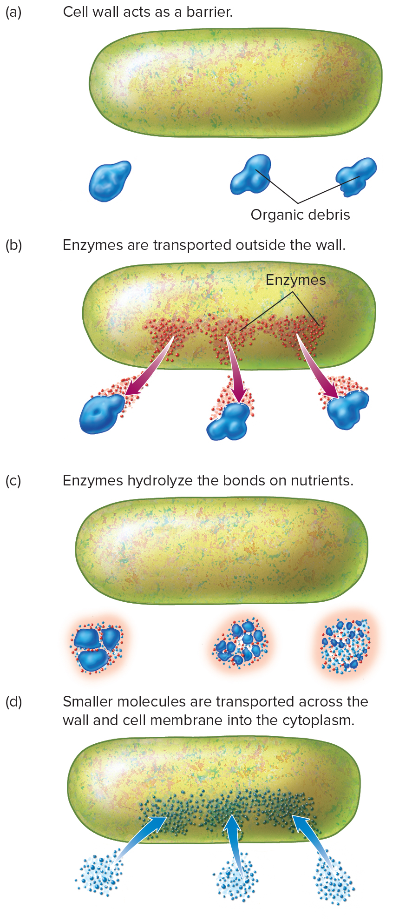
Heterotrophs and Their Energy Sources
The figure of “Heterotrophs and Their Energy Sources.”
Cell wall acts as a barrier.
Enzymes are transported outside the wall.

Slide 29
Heterotrophs and Their Energy Sources
The figure of “Heterotrophs and Their Energy Sources” continues on this slide.
Enzymes hydrolyze the bonds on nutrients.
Smaller molecules are transported across the wall and cell membrane into the cytoplasm.

Slide 30
Transport: Movement of Substances Across the Cell Membrane
Passive transport – does not require energy; substances exist in a gradient and move from areas of higher concentration toward areas of lower concentration
  Diffusion
  Osmosis – diffusion of water
  Facilitated diffusion – solutes that require a carrier

Slide 31
Transport: Movement of Substances Across the Cell Membrane
Active transport – requires energy and carrier proteins; gradient independent
  Carrier-mediated active transport
  Group translocation – transported molecule chemically altered
  Bulk transport – endocytosis, exocytosis, pinocytosis

Slide 32
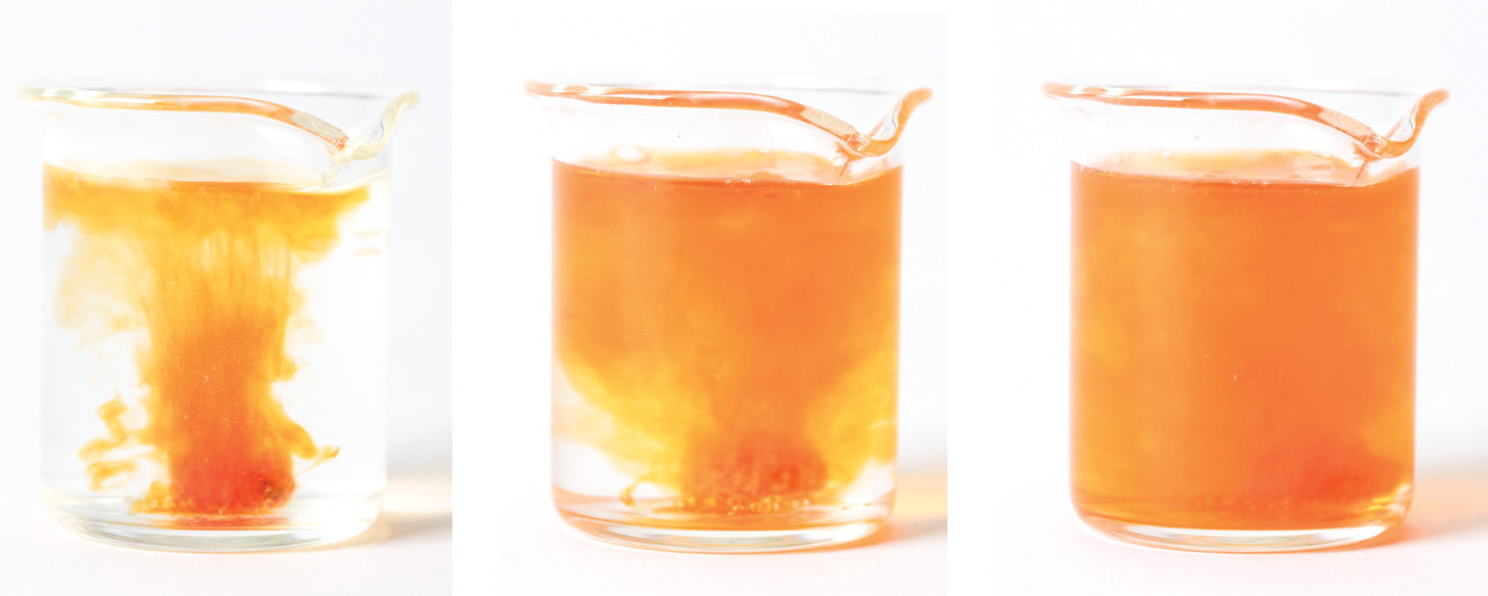
Diffusion and Molecular Motion
Net Movement of molecules down their concentration gradient by random thermal movement (passive transport)

Slide 33
Diffusion of Water: Osmosis
Living membranes generally block the entrance and exit of larger molecules and permit free diffusion of water (passive transport)
When concentrations of the solutions differ, one side will experience a net loss of water and the other a net gain of water until equilibrium is reached

Slide 34
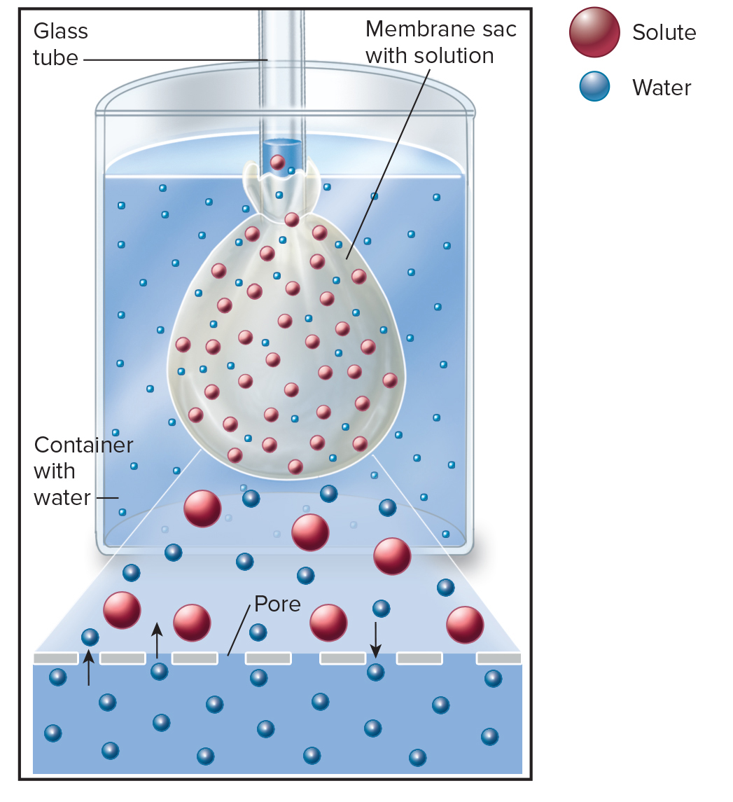
Diffusion of Water: Osmosis 2
The figure of “Osmosis.”
Inset shows a close-up of the osmotic process. The gradient goes from the outer container (higher concentration of H₂O) to the sac (lower concentration of H₂O).

Slide 35
Movement of Solutes: Facilitated Diffusion
Passive transport mechanism that utilizes a carrier protein in the membrane that will bind a specific substance
Carrier proteins exhibit specificity (they bind and transport only a single type of molecule)
Facilitated diffusion exhibits saturation (rate of transport limited by the number of binding sites on the transport proteins)

Slide 36
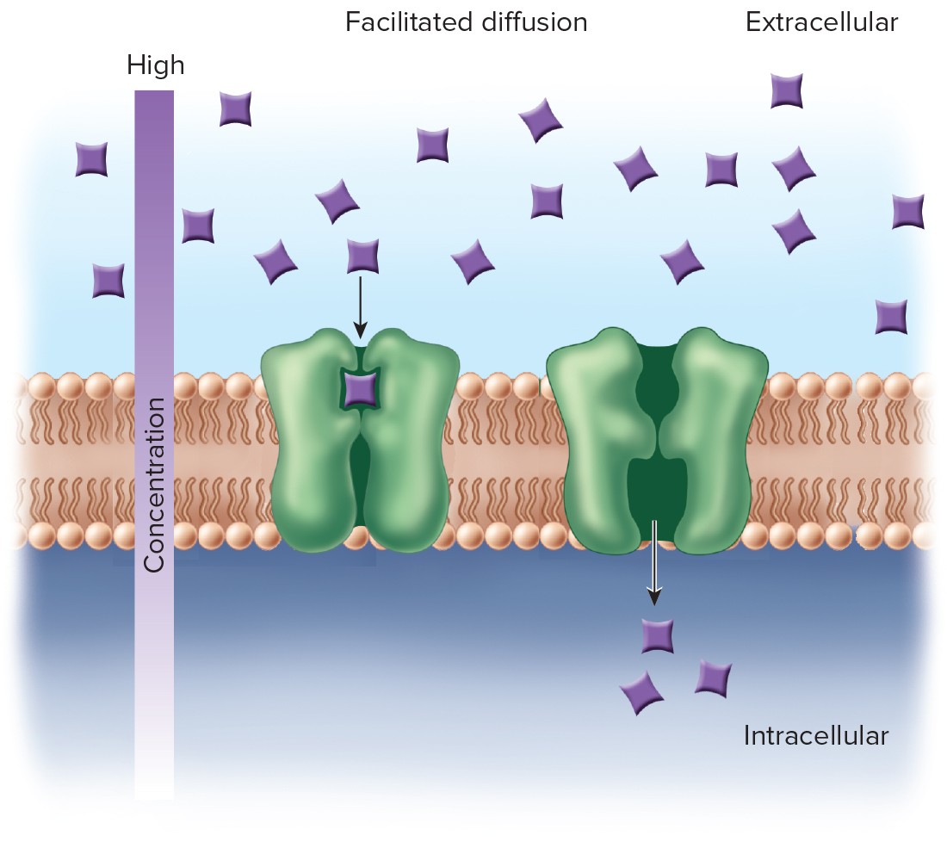
Movement of Solutes: Facilitated Diffusion

Slide 37
Carrier Mediated Active Transport
Permeases and pumps: Specific membrane–bound transporter proteins that interact with nearby solute-binding proteins that carry essential solutes (sodium, iron, sugars)
Once a solute-binding protein attaches to a specific site in the transporter protein, an ATP is activated and generates energy to pump the solute into the cell’s interior through a special channel.

Slide 38
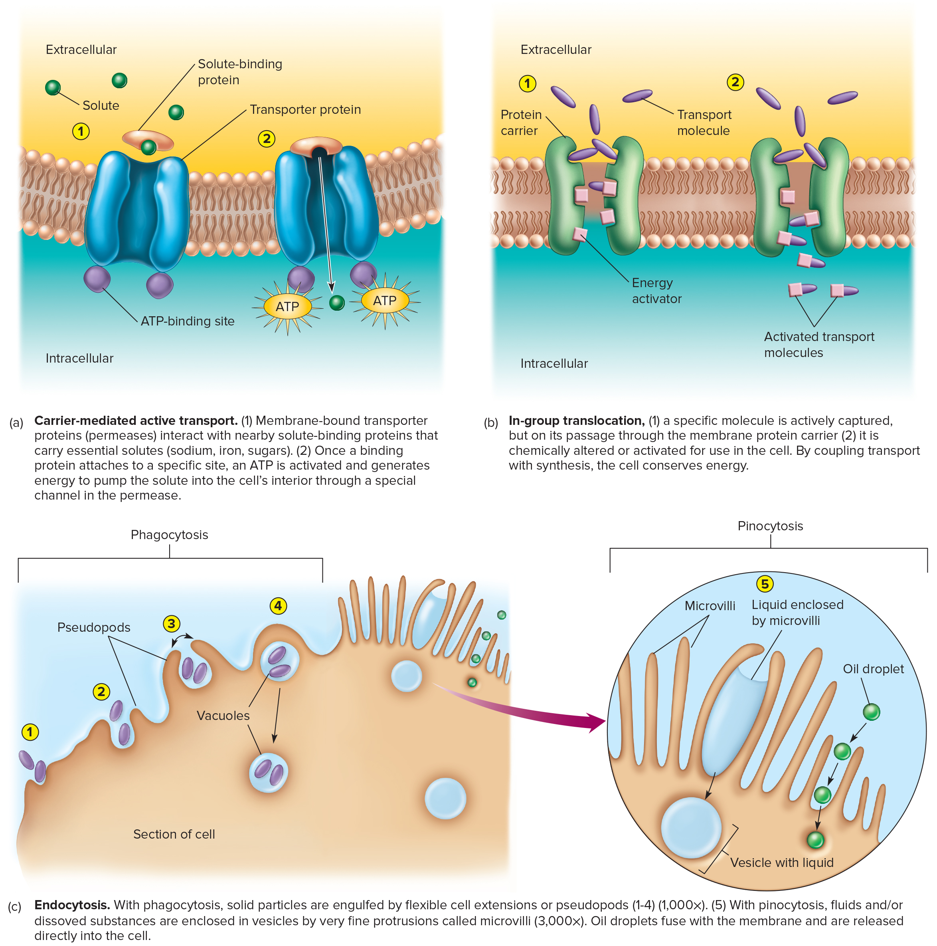
Carrier Mediated Active Transport
The figure of “Carrier Mediated Active Transport.”
Carrier-mediated active transport. (1) Membrane-bound transporter proteins (permeases) interact with nearby solute binding proteins that carry essential solutes (sodium, iron, sugars). (2) Once a binding protein attaches to a specific site, an ATP is activated and generates energy to pump the solute into the cell's interior through a special channel in the permease.

Slide 39
In Group Translocation
Another type of active transport in which energy is conserved by coupling transport with synthesis
A specific molecule is actively captured, but it is chemically altered or activated for use in the cell on its passage through the membrane protein carrier

Slide 40
In Group Translocation
In group translocation, (1) a specific molecule is actively captured, but on its passage through the membrane protein carrier (2) it is chemically altered or activated for use in the cell. By coupling transport with synthesis, the cell conserves energy.

Slide 41
Endocytosis: Eating and Drinking by Cells 1
Endocytosis: bringing substances into the cell through a vesicle or phagosome
  Phagocytosis ingests substances or cells (pseudopods)
  Pinocytosis ingests fluids and/or dissolved substances (microvilli)

Slide 42
Endocytosis: Eating and Drinking by Cells 2
Endocytosis. With phagocytosis, solid particles are engulfed by flexible cell extensions or pseudopods (1-4) (1,000x). (5) With pinocytosis, fluids and/or dissolved substances are enclosed in vesicles by very fine protrusions called microvilli (3.000x). Oil droplets fuse with the membrane and are released directly into the cell.

Slide 43
TABLE 7.3 Summary of Transport Processes in Cells 1
General Process | Nature of Transport | Examples | Description | Qualities
Passive | Energy expenditure by the cell is not required. Substances exist in a gradient and move from areas of higher concentration toward areas of lower concentration in the gradient. | Diffusion osmosis | A fundamental property of atoms and molecules that exist in a state of random motion | Nonspecific Brownian movement Movement of small uncharged molecules across membranes
 |  | Facilitated diffusion | Molecule binds to a carrier protein in membrane and is carried across to other side. | Molecule specific; transports both ways Transports sugars, amino acids, water
Active | Energy expenditure is required. Molecules need not exist in a gradient. Rate of transport is increased. Transport may occur against a concentration gradient. | Carrier-mediated active transport | Atoms or molecules are pumped into or out of the cell by specialized receptors; driven by ATP or other high- energy molecules | Transports simple sugars, amino acids, inorganic ions (Na⁺, K⁺)
Notes:
Copyright © 2018 McGraw-Hill Education. All rights reserved. No reproduction or distribution without the prior written consent of McGraw-Hill Education

Slide 44
TABLE 7.3 Summary of Transport Processes in Cells 2
General Process | Nature of Transport | Examples | Description | Qualities
 |  | Group translocation | Molecule is moved across membrane and simultaneously converted to a metabolically useful substance. | Alternate system for transporting nutrients (sugars, amino acids)
 |  | Bulk transport | Mass transport of large particles, cells, and liquids by engulfment and vesicle formation | Process is endocytosis; examples are phagocytosis and pinocytosis

